Slide 1


Slide 2

Topics
What is Dynamo-DB?
The basics of DynamoDB
Advance in DynamoDB
Backup and Restore in DynamoDB
Security in DynamoDB
Exam Tip

Slide 3

What is DynamoDB?
Amazon DynamoDB is a fast and flexible NoSQL database service for all application that need consistent, single-digit millisecond latency at any scale.
DynamoDB enables customers to offload the administrative burdens of operating and scaling distributed databases to AWS so that they don’t have to worry about hardware provisioning, setup and configuration, throughput capacity planning, replication, software patching, or cluster scaling.
It is a fully managed database and supports both document and key-value data models (JSON, HTML and XML). Its flexible data model and reliable performance make it a great fit for mobile, web, gaming, ad-tech, IoT and many other applications

Slide 4
DynamoDB
{
"id": "9923810800391",
"firstname": "sanjay",
"surname": "gupta",
"age": "23",
"address": [
{
"street": "f-7 sujata flat",
"suburb": "sahi bag",
"city": "ahmedabad",
"pincode": "293772"
}
]
}

Slide 5
The basics of DynamoDB
In DynamoDB, tables, items, and attributes are the core components. A table is a collection of items, and each item is a collection of attributes.
Stored on solid-state disks (SSDs)
Automatically replicated across multiple Availability Zones in an AWS Region, providing built-in high availability and data durability
Eventual Consistent Reads(default)
Strongly Consistent Reads

Slide 6

The basics of DynamoDB
Eventual Consistent Reads:
Consistency across all copies of data is usually reached within a second.
Repeating a read after a short time should return the updated data. (Best Read Performance)
Strongly Consistent Reads
A Strongly consistent read returns a result that reflects all writes that received a successful response prior to the read.

Slide 7
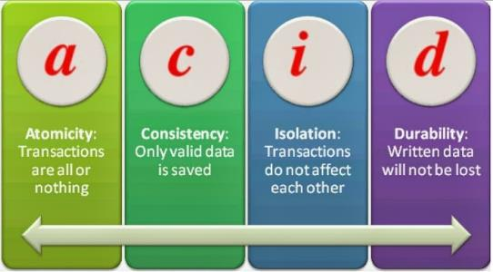
The basics of DynamoDB
ACID transactions
DynamoDB transactions provide developers atomicity, consistency, isolation, and durability (ACID)
Read or write multiple items across multiple tables as an "all-or-nothing" Operations
Financial transactions
Fulfilling orders
Two underlying reads or writes - prepare/commit
Up to 25 items or 4 MB of data

Slide 8
The basics of DynamoDB
Primary Keys
DynamoDB Stores and retrieves data based on a primary key.
When you create a table, in addition to the table name, you must specify the primary key of the table.
The primary key uniquely identifies each item in the table, so that no two items can have the same key
Two type :
Partition key
Composite key (partition key + sort key)

Slide 9
The basics of DynamoDB
Partition key:
A unique attribute
Example: CustomerId = 2138812123, personid, productid, email address, vehicle registration number.
Value of the partition key is input to an internal hash function which determines the partition or physical location on which the data is stored.
If you are using the partition key as your primary key, then no two items can have same partition key.

Slide 10
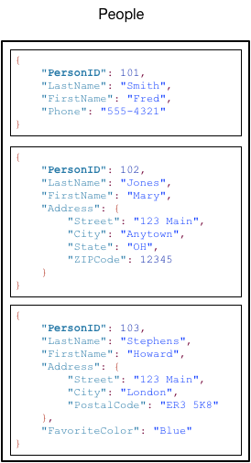
The basics of DynamoDB

Slide 11
The basics of DynamoDB
Composite key
1. Partition key + Sort key
Forum posts. User post multiple messages
Combination of : userid + sort key (timestamp)
Example: Artist + SongTitle
2. A Unique Combination
Items in the table may have the same partition key, but they must have a different sort key
3. Storage
All items with the same partition key are stored together and then sorted according to the sort key value

Slide 12
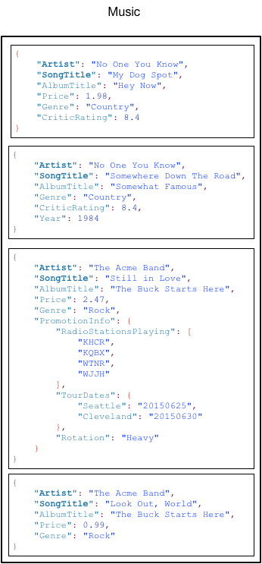
The basics of DynamoDB

Slide 13
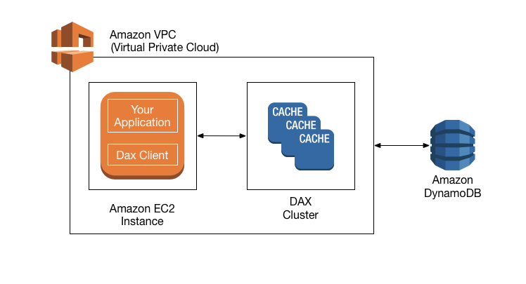
Advance in DynamoDB
DynamoDB Accelerator(DAX):
Fully Managed, High available, in-memory cache
10x performance improvement
Reduces request time from milliseconds to microseconds - even under load
No need for developers to manage caching logic
Compatible with DynamoDB API calls

Slide 14

Advance in DynamoDB
On-Demand Capacity:
Pay-per-request pricing
Balance cost and performance
No minimum capacity
No charge for read/write - only storage and backup
Pay more per request than with provisioned capacity
Use for new product launches

Slide 15

Advance in DynamoDB
Global Tables
Managed Multi-Master, Multi-Region Replication
Globally distributed applications
Based on DynamoDB Streams
Multi-Region redundancy for DR or HA
No application rewrites
Replication latency under one second

Slide 16
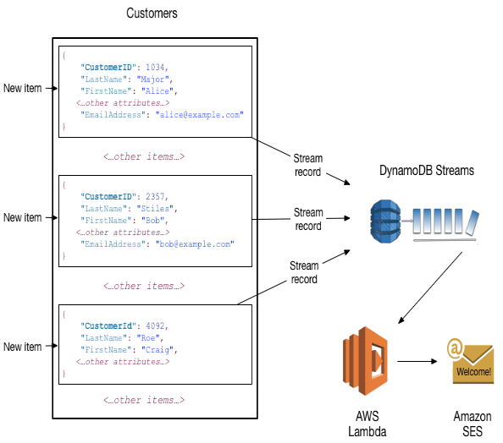
Advance in DynamoDB
Streams
Time-ordered sequence of item-level changes in a table
Stored for 24 hours
Insert, updates and deletes
Combine with lambda functions for functionality like stored procedures

Slide 17

Backup and Restore in DynamoDB
On-Demand Backups and Restore
Full Backups at any time
Zero impact on table performance or availability
Consistent within seconds and retained until deleted
Operates within same region as the source table
Point-in-Time Recovery (PITR)
Protects against accidental writes or deletes
Restore to any point in the last 35 days
Incremental backups
Not enabled by default
Latest restorable: five minutes in the past

Slide 18

Security in DynamoDB
Encryption at rest using KMS
Site-to-site VPN
Direct Connect (DX)
IAM policies and roles
Fine-grained access
CloudWatch and CloudTrail
VPC endpoints

Slide 19

Exam Tips:
Amazon DynamoDB is a fast and flexible NoSQL database service for all application that need consistent, single-digit millisecond latency at any scale
Stored on solid-state disks (SSDs)
Automatically replicated across multiple Availability Zones
Eventual Consistent Reads(default)
Strongly Consistent Reads
ACID transactions

Slide 20
Exam Tips:
Primary Keys
DynamoDB Stores and retrieves data based on a primary key.
Two type :
Partition key :- A unique attribute
Composite key : partition key + sort key
DynamoDB Accelerator
On-Demand Capacity
Backup and Restore
Point-in-Time Recovery

Slide 21
Exam Tips:
Streams:
Time-ordered sequence of item-level changes in a table
Global Tables:
Managed Multi-Master, Multi-Region Replication
Security:
Encryption at rest using KMS
IAM policies and roles
CloudWatch and CloudTrail

Slide 22
Thank you

